Slide 1
The qualityof HEAlth care
Made by
Secarea Diana
Stela Stoimenova
Toma Bianca

Slide 2
1. Explain the selection of the variables; describe the data sources and the metadata for the selected variables.
The variables we have chosen are taken from https://insse.ro/cms/ (the TEMPO section). We selected them as we wanted to see the correlation of all the variables with each other and ,thus,provide an insight into the impact they have on the health system .Our metadata is comprised of classes pertaining health personnel(physicians and family doctors),mortality ,number of hospitals and hospital capacity(beds).

Slide 3
I. Explain the relevance of your analysis and use some references in this purpose. literature REVIew
Considering the fact that inhospitality mortality rate records an increase in 2019,which raises eyebrows concerning hospice and nursing home conditions , [1],being the focus of our analysis.A study made by Cristian Vladescu, Marius Ciutan and Alexandru Rafila about the advent of COVID-19 events[2] shows nothing ,but that having difficulty with hospital capacity and economic weakness has had a negative effect on the well-being of the population that’s suffered from COVID or not .
Thus ,our analysis is relevant in the context of health care quality.

Slide 4
2. Describe your data with graphical tools; No. of Hospitals

Slide 5
2. Describe your data with graphical tools; No. of Hospitals

Slide 6
2. Describe your data with graphical tools; No. of Hospitals

Slide 7
2. Describe your data with graphical tools; No. of Hospitals

Slide 8
2. Describe your data with graphical tools; No. of Hospitals

Slide 9
3. Group the statistical units into classes; plot the histograms, based on your classification.
Bin(upper limit)
9
15
21
27
32
37
bin label
(4-9)
(10-15)
(16-21)
(22-27)
(28-32)
(32-37)
Bin | Frequency
(4-9) | 16
(10-15) | 5
(16-21) | 4
(22-27) | 2
(28-32) | 1
(32-37) | 1
More | 0
STURGE’S RULE:1+3.3*log(N)
N=30
STURGE’S RULE=6
Range( R )=33 (xmax-xmin,largest-lowest value)
K=R/N=5.5->size

Slide 10
3. Group the statistical units into classes; plot the histograms, based on your classification.
Bin(upper limit) | bin labels
436 | (313-436)
543 | (456-543)
630 | (565-630)
984 | (672-984)
1561 | (1065-1561)
5294 | (2035-5294)
Range= 4981
K= 1.1

Slide 11
3. Group the statistical units into classes; plot the histograms, based on your classification.
bin | bins label
108 | (80-108)
141 | (133-141)
174 | (153-174)
250 | (193-250)
362 | (256-362)
542 | (387-542)
Range=462
K=15.4

Slide 12
3. Group the statistical units into classes; plot the histograms, based on your classification.
bin | bin labels
1303 | (831-1303)
1913 | (1327-1913)
2191 | (1951-2191)
2920 | (2340-2920)
3877 | (2965-3877)
7575 | (4160-7575)
Range=6744
K=224.8

Slide 13
3. Group the statistical units into classes; plot the histograms, based on your classification.
bin | bin labels
3924 | (2766-3924)
4646 | (4087-4646)
5729 | (4836-5729)
6981 | (5995-6981)
8193 | (7195-8193)
11195 | (8697-11195)
Range=8439
K=281.3

Slide 14
4.Summarize sample data using the descriptive statistics measures. Apply Excel facilities and comment the results. (Hospitals)
*the quadratic mean-measures the absolute magnitude of a set of numbers
*the harmonic mean -always shows the lowest value among the Pythagorean means.
*the geometric mean-the average value or mean which signifies the central tendency of the set of numbers by taking the root of the product of their values.
*The arithmetic mean represents the average value of your dataset which in this case is aproximately 11,27.
*The standard error provides an estimate of how much the sample mean might differ from the true population mean and lower standard error suggests that the sample mean is a more reliable estimate of the population mean.
*The median is the middle value of your dataset. In this case, half of the observations fall below 7, and half fall above 7. It is less affected by extreme values compared to the mean.
*The mode is 4 ,because it appears most frequently.
*The standard deviation measures the dispersion or spread of our data. A higher standard deviation indicates greater variability. In this case, a standard deviation of 8.49 suggests a relatively wide spread of values.
*The sample variance is the average of the squared differences from the mean, so we have 72,06 which indicates high variability.

Slide 15
4.Summarize sample data using the descriptive statistics measures. Apply Excel facilities and comment the results. (hospitals)
*Kurtosis measures the tailedness of the data distribution. A positive kurtosis value suggests that the data distribution has heavier tails than a normal distribution. It may indicate the presence of outliers. (Leptokurtic = thin distribution
(concentrated at midpoint)>0)
*Skewness measures the asymmetry of the data distribution. A positive skewness value indicates a right-skewed distribution. In this case, the distribution may have a tail on the right side.(skewed to the right,as the skewness is closer to 1,towards infinity)
*Range is the difference between the maximum and minimum values in your dataset. In this case, the range is 33, providing insight into the spread of values.
No. of hospitals
Mean | 11.26667
Standard Error | 1.549886
Median | 7
Mode | 4
Standard Deviation | 8.489073
Sample Variance | 72.06437
Kurtosis | 1.778792
Skewness | 1.450725
Range | 33
Minimum | 4
Maximum | 37
Sum | 338
Count | 30

Slide 16
4.Summarize sample data using the descriptive statistics measures. Apply Excel facilities and comment the results. (Physicians)
Mean | 1178
Standard Error | 218.537
Median | 651
Mode | none
Standard Deviation | 1196.976
Sample Variance | 1432752
Kurtosis | 5.176086
Skewness | 2.29654
Range | 4981
Minimum | 313
Maximum | 5294
Sum | 35340
Count | 30
Kurtosis->Leptokurtic = thin distribution
(concentrated at midpoint)>0
Skewness->skewed to the right,as the skewness is closer to 1,towards infinity.

Slide 17
4.Summarize sample data using the descriptive statistics measures. Apply Excel facilities and comment the results.(Family doctors)
Mean | 230.6333
Standard Error | 23.1948
Median | 183.5
Mode | 108
Standard Deviation | 127.0432
Sample Variance | 16139.96
Kurtosis | -0.05612
Skewness | 0.925023
Range | 462
Minimum | 80
Maximum | 542
Sum | 6919
Count | 30
Kurtosis->Platykurtic = flat distribution<0
Skewness->skewed to the right,as the skewness is closer to 1,towards infinity.

Slide 18
4.Summarize sample data using the descriptive statistics measures. Apply Excel facilities and comment the results. (Beds)
Mean | 2709.6
Standard Error | 298.1491
Median | 2265.5
Mode | 831
Standard Deviation | 1633.03
Sample Variance | 2666787
Kurtosis | 2.783357
Skewness | 1.567735
Range | 6744
Minimum | 831
Maximum | 7575
Sum | 81288
Count | 30
Kurtosis->Leptokurtic = thin distribution
(concentrated at midpoint)>0
Skewness->skewed to the right,as the skewness is closer to 1,towards infinity.

Slide 19
4.Summarize sample data using the descriptive statistics measures. Apply Excel facilities and comment the results. (Deaths)
Mean | 6136.967
Standard Error | 394.8307
Median | 5862
Mode | none
Standard Deviation | 2162.577
Sample Variance | 4676739
Kurtosis | -0.58928
Skewness | 0.388198
Range | 8439
Minimum | 2756
Maximum | 11195
Sum | 184109
Count | 30
Kurtosis->Platykurtic = flat distribution<0
Skewness->skewed to the right,as the skewness is closer to 1,towards infinity.

Slide 20
5. Develop scatter diagrams using two numerical variables.
What does the scatter diagram indicate about the relationship between the two variables?
Considering that as the doctors increase ,the beds increase as well,it’s a strong positive correlation.

Slide 21

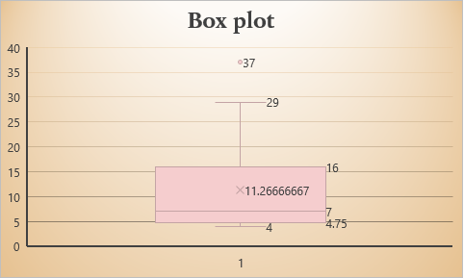
6. Identify the outliers. Develop and discuss the boxplot for the distribution of each variable. (Hospitals)
Each boxplot has whiskers where it’s depicted by the drawing.
Q1 | 5
Q3 | 15.75
IRQ | 10.75
Lower Bound | -11.125
Upper Bound | 31.875
Outliers | Cluj | 37
The boxplot is a visual representation of IQR and outliers. The box spans approximately from -11 to 31 and the outliers are represented beyond the lower and upper bounds , that's why Cluj is an outlier with values significantly different from the majority

Slide 22
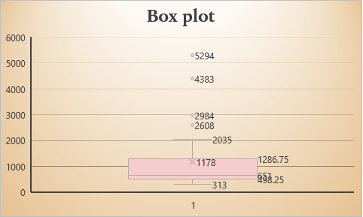
6. Identify the outliers. Develop and discuss the boxplot for the distribution of each variable. (Physicians)
Q1 | 508.75
Q3 | 1201.5
IRQ | 692.75
Lower Bound | -530.375
Upper Bound | 2240.625
Outliers | Cluj | 4383
 | Mures | 2984
 | Iasi | 5294
 | Constanta | 2608
The boxplot is a visual representation of IQR and outliers. The box spans approximately from -530 to 2240 and the outliers are represented beyond the lower and upper bounds , that's why Cluj, Mures, Iasi and Constanta are the outliers with values significantly different from the majority

Slide 23
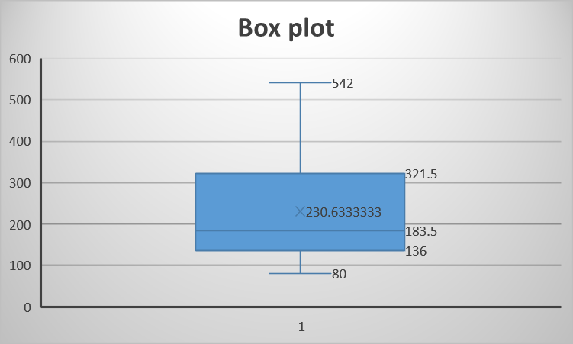
6. Identify the outliers. Develop and discuss the boxplot for the distribution of each variable. (Family doctors)
Q1 | 138
Q3 | 312
IRQ | 174
Lower Bound | -123
Upper Bound | 573
Outliers | NONE
The boxplot is a visual representation of IQR and outliers. The box spans approximately from -123 and 573 and that is why there are not any outliers.

Slide 24
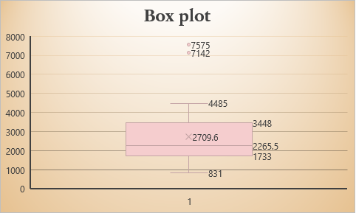
6. Identify the outliers. Develop and discuss the boxplot for the distribution of each variable. (Beds)
Q1 | 1805.5
Q3 | 3316
IRQ | 1510.5
Lower Bound | -460.25
Upper Bound | 5581.75
Outliers | Neamt | 7575
 | Maramures | 7142
The boxplot is a visual representation of IQR and outliers. The box spans approximately from -460 to 5581 and the outliers are represented beyond the lower and upper bounds , that's why Neamt and Maramures are the outliers, with values significantly different from the majority

Slide 25
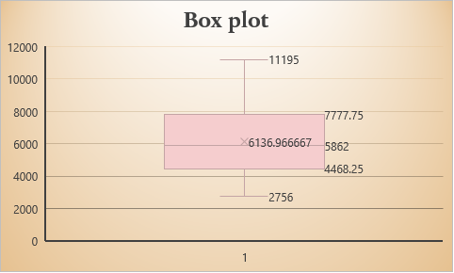
6. Identify the outliers. Develop and discuss the boxplot for the distribution of each variable. (deaths)
Q1 | 4519.5
Q3 | 7622.25
IRQ | 3102.75
Lower Bound | -134.625
Upper Bound | 12276.38
Outliers | Cluj | 7142
 | Iasi | 7575
The boxplot is a visual representation of IQR and outliers. The box spans approximately from -134 to 12276 and the outliers are represented beyond the lower and upper bounds , that's why Cluj and Iasi are the outliers with values significantly different from the majority

Slide 26
7.Using Excel functions, compute covariance and coefficient of correlation. Comment the results. At this point, make sure that the variables included in the analysis ARE COMPARABLE.
Sample Covariance
 | No. of hospitals | Physicians (dentists excluded) | Family doctors | No. of the beds from sanitary units | No. of deaths
No. of hospitals | 72.06436782
Physicians (dentists excluded) | 8743.172414 | 1432752.069
Family doctors | 984.8597701 | 138245.7241 | 16139.96437
No. of the beds from sanitary units | 12972.0069 | 1840020.448 | 196808.2966 | 2666786.731
No. of deaths | 13919.45747 | 1576528.724 | 221277.4701 | 2770369.641 | 4676739.275
We have positive covariance.A positive covariance means that both variables tend to be high or low at the same time .

Slide 27
7.Using Excel functions, compute covariance and coefficient of correlation. Comment the results. At this point, make sure that the variables included in the analysis ARE COMPARABLE.
We did the Sample covariance which is used when you only have a sample from the population and want to estimate the covariance for the entire population and the Population covariance is used when you have data for the entire population and want to understand the relationship between two variables. In our case there is not big of a difference between the two tables but the sample covariance is the better option because we need to compare it with the coefficient of correlation.
Correlation coefficients provide a standardized measure of the strength and direction of linear relationships, while covariance values are in the units of the variables.The correlation matrix ranges from -1 to 1, while the covariance matrix can take any real value.Interpretation of correlation coefficients is more straightforward (e.g., a correlation of 0.8 indicates a strong positive relationship), while interpretation of covariance values requires considering the scale of the variables.

Slide 28
8.Use a selection of 10 units and Analyze the correlation between two variables using two non-parametric coefficients. (SPEARMAN)
No. of hospitals | Physicians (dentists excluded) | Region | R_{x} | R_{y} | d_{i} | d_{i}²
4 | 504 | Bistrita-Nasaud | 1.5 | 3 | -1.5 | 2.25
37 | 4383 | Cluj | 10 | 10 | 0 | 0
15 | 948 | Maramures | 7 | 7 | 0 | 0
6 | 630 | Satu Mare | 3.5 | 5 | -1.5 | 2.25
6 | 456 | Salaj | 3.5 | 2 | 1.5 | 2.25
11 | 672 | Alba | 6 | 6 | 0 | 0
23 | 2035 | Brasov | 9 | 8 | 1 | 1
4 | 436 | Covasna | 1.5 | 1 | 0.5 | 0.25
7 | 620 | Harghita | 5 | 4 | 1 | 1
16 | 2984 | Mures | 8 | 9 | -1 | 1
Spearman correlation | 0.939042
Pearson correlation | 0.916995
Spearman correlation coefficient | 0.939394
N | 10
T statistic | 7.725391
Degrees of freedom | 8
p value | 5.61E-05
0.9 < ρ (rs) < 1: Strong positive monotonic relationship(Spearman)
0.9<r<1: Strong positive linear relationship(Pearson)

Slide 29
8.Use a selection of 10 units and Analyze the correlation between two variables using two non-parametric coefficients. (KENDALL)
Rule
concordant if (xi > xj and yi > yj) or (xi < xj and yi < yj)
discordant if (xi > xj and yi < yj) or (xi < xj and yi > yj)
neither if xi = xj or yi = yj (i.e. ties are not counted).
No. of hospitals | Physicians (dentists excluded) | Region | Concordant | Discordant
4 | 504 | Bistrita-Nasaud | 7 | 1
37 | 4383 | Cluj | 9 | 0
15 | 948 | Maramures | 9 | 0
6 | 630 | Satu Mare | 7 | 1
6 | 456 | Salaj | 7 | 1
11 | 672 | Alba | 9 | 0
23 | 2035 | Brasov | 8 | 1
4 | 436 | Covasna | 8 | 0
7 | 620 | Harghita | 8 | 1
16 | 2984 | Mures | 8 | 1
 |  |  | 80 | 6 | SUM
Kendall’s Tau 0.860465116 (very strong positive correlation)⬄if the correlation is between 0.8-1

Slide 30
REFERENCES
1-chrome-extension://efaidnbmnnnibpcajpcglclefindmkaj/https://www.rjlm.ro/system/revista/52/399-404.pdf
2-https://www.ncbi.nlm.nih.gov/pmc/articles/PMC9719376/

Slide 31
THANK YOU
Secarea Diana
Stoimenova Stela
Toma Bianca

